Slide 1

BEYOND KILLER ROBOTS: HUMANS, MACHINES, AND WEAPONS

Slide 2
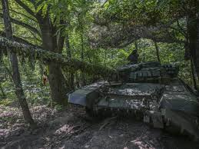

Slide 3
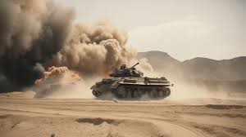

Slide 4
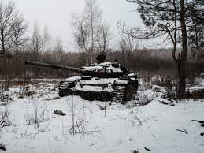

Slide 5
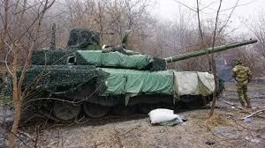

Slide 6
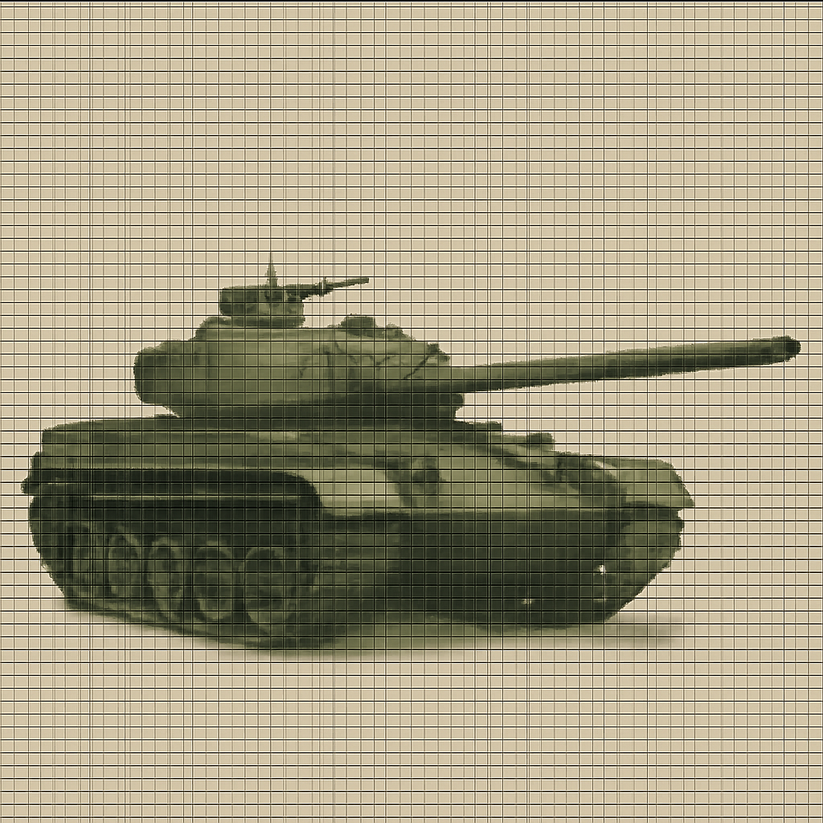

Slide 7
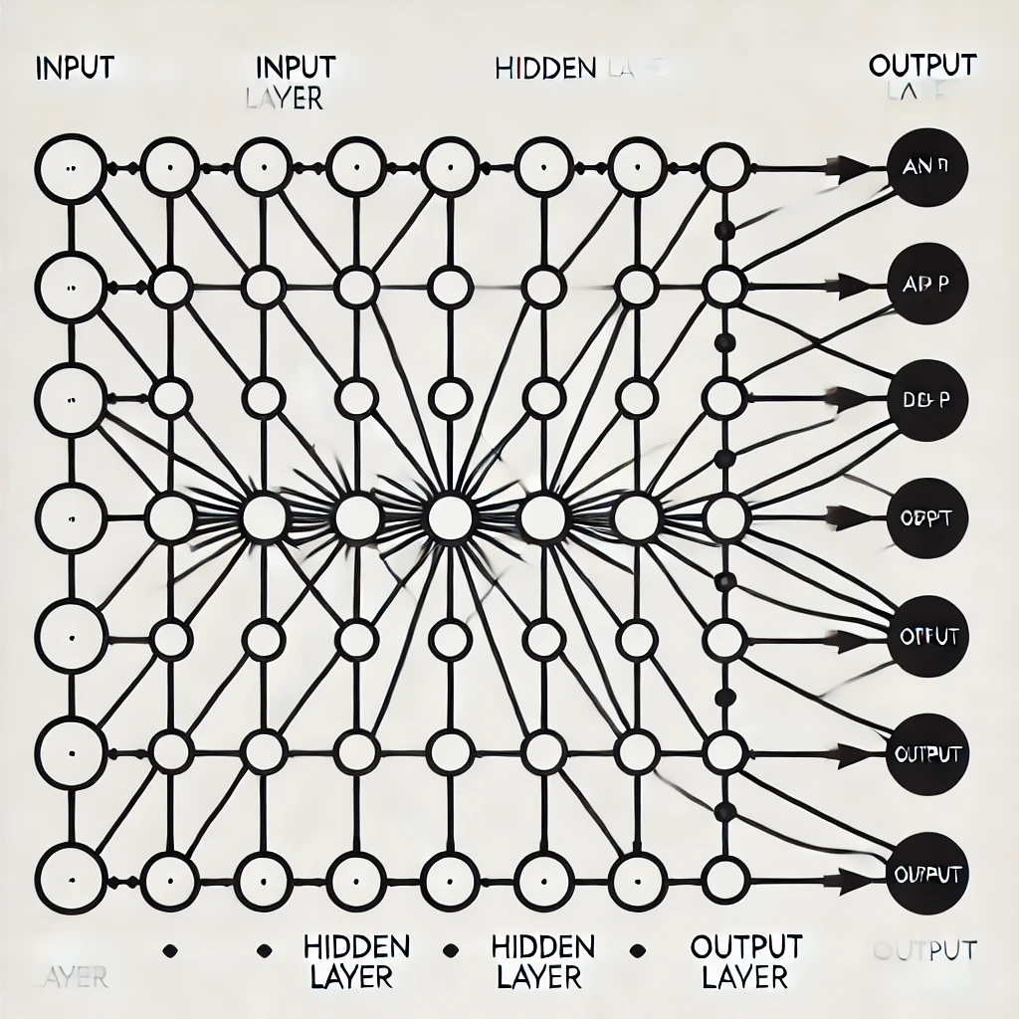

Slide 8
HUMAN OUT OF THE LOOP FULLY AUTONOMOUS
“After initial activation or launch by a person, an autonomous weapon system self-initiates a strike in response to information from the environment received through sensors and on the basis of a generalized "target profile.“
-- International Committee of the Red Cross

Slide 9
HUMAN ON THE LOOP OPERATOR-SUPERVISED AUTONOMOUS
“An autonomous weapon system that is designed to provide operators with the ability to intervene and terminate engagements.”
-- US Department of Defense

Slide 10
HUMAN IN THE LOOP SEMIAUTONOMOUS
“A weapon system that, once activated, is intended to only engage individual targets or specific target groups that have been selected by an operator.”
-- US Department of Defense

Slide 11
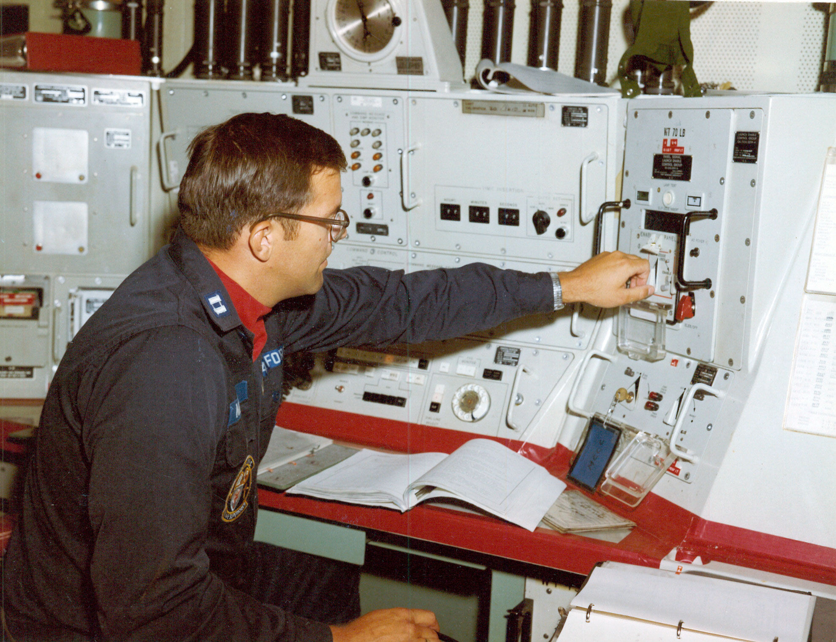
NUCLEAR WARNING SYSTEM

Slide 12
CONVENTION ON CERTAIN CONVENTIONAL WEAPONS
Designed to ban ore restrict “weapons, projectiles and material and methods of warfare of a nature to cause superfluous injury or unnecessary suffering.”
Current prohibitions on land mines, booby traps, incendiary devices, and blinding laser weapons.
Should lethal autonomous weapons systems (LAWS) be banned or restricted?

Slide 13

UN WORKING GROUP LETHAL AUTONOMOUS WEAPON SYSTEMS (LAWS)

Slide 14
UN LAWS WORKING GROUP
“LAWS may only be used in accordance with IHL, including the principles and requirements of distinction, proportionality and precautions in attack.”

Slide 15
CORE IHL PRINCIPLES
Distinction: may not intentionally target civilians or civilian objects
Proportionality: Expected intended civilian harm from an attack may not be excessive compared to the anticipated military advantage from the attack
Precautions: Must take all feasible precautions to minimize unintended civilian harm from an attack

Slide 16
UN LAWS WORKING GROUP
“Context-appropriate human judgement and control is needed to ensure the use and effects of LAWS are in compliance with international law, in particular IHL.”

Slide 17
TWO QUESTIONS
Is having a human in the loop sufficient to ensure that use of a weapon with AI capabilities is based on human judgment?
Is this enough?
Is having a human in the loop necessary to ensure that use of a weapon with AI capabilities is based on human judgment?
Can use of a weapon be based on human judgment even if a human is not in the loop?

Slide 18

JOINT PUBLICATION 3-60
Joint Targeting Cycle
1.
End State and Commander’s Objectives
6.
Assessment
2.
Target Development and Prioritization
5.
Mission Planning and Force Execution
3.
Capabilities Analysis
4.
Commander’s Decision and Force Assignment

Slide 19
STAGE ONE COMMANDER’S OBJECTIVES
What goals does a commander want to accomplish by striking enemy military targets?
Translate these goals into specific targeting tasks.
This “ensures that each target can be traced back to clearly defined and attainable goals.”
Produces broad set of potential targets for further analysis.
* Description of activities in each stage drawn from Merel Ekelhof, “Lifting the Fog of Targeting: ‘Autonomous Weapons’ and Human Control through the Lens of Military Targeting,” Naval War College Review: Vol. 71 : No. 3 , Article 6.

Slide 20
STAGE ONE POTENTIAL USES OF AI
Rapidly analyze vast amounts of intelligence data from all sources to identify potential targets
Assess relative value of those assets in the enemy’s overall military asset network, based on models that reflect the relationships among them.
Model effects on the enemy’s network of striking different targets
Generate different scenarios to identify how to use targeting to best achieve commander’s objectives.

Slide 21
STAGE TWO TARGET DEVELOPMENT
Detailed analysis of each potential target.
Confirm intelligence on characteristics of the target.
Determine role that target plays in overall enemy system
Potential harm to civilians and civilian objects
Develop restricted target list and no-strike list.
Assess priorities among targets
Present proposed target list to commander.

Slide 22
STAGE TWO POTENTIAL USES OF AI
Detect patterns and anomalies that human analysts might miss.
Use more detailed models of relationships among targets to generate scenarios based on different combinations of strikes on different targets.
Cross-reference potential targets against databases of protected sites (e.g., hospitals, schools, cultural heritage sites) to help ensure compliance with international law.
Use LLMs to analyze intelligence and diplomatic reports to assess likely reaction to destroying particular targets.

Slide 23
STAGE THREE CAPABILITIES ANALYSIS
Analyze prioritized targets and match to them to the most appropriate available weapons to generate the desired effects.
What is the probability of success and risk associated with striking each potential target?
Estimated civilian harm from using each type of weapon.
Produce list of targets to commander for authorization to begin planning missions for specific strikes

Slide 24
STAGE THREE POTENTIAL USES OF AI
Model different weapons systems and their effects, taking into account factors like weather, terrain, and civilian presence.
Weaponeering: for each target, “recommendation of the quantity, type, and mix of weapons to achieve the desired effects while avoiding unacceptable collateral damage.”
Detailed civilian harm estimate for each target
Automated pairing of capability to target based on effectiveness of weapon and collateral damage estimate.

Slide 25
STAGE FOUR COMMANDER’S DECISION AND FORCE ASSIGNMENT
Final approval of prioritized targets.
Assign these to different units for planning and execution.
What rules of engagement apply to strike on each target?
What are best weapons to use for these strikes, based on effectiveness and civilian harm estimate?

Slide 26
STAGE FOUR POTENTIAL USES OF AI
Models analyze historical data and current intelligence to assess risks to friendly forces and civilians
Models identify adjustments that may lower civilian harm below collateral damage estimate
Automated generation of strike packages to achieve desired effects while minimizing collateral damage
Optimization of effects based on limited available forces and capabilities.

Slide 27
STAGE FIVE MISSION PLANNING AND EXECUTION
Find lawful target
Fix: confirm positive identification of target
Track target if mobile
Target: authorize strike after confirming consistency with law, rules of engagement, risks to civilians and own forces
Fire on target

Slide 28
STAGE FIVE POTENTIAL USES OF AI
Individual target verification
Route-planning algorithms can determine safest and most effective routes for aircraft or other targeting platforms.
Assist in deconfliction to avoid airspace or other operational conflicts
Help optimize timing and sequencing in complex operations with multiple assets
Terminal guidance to home in on selected targets

Slide 29
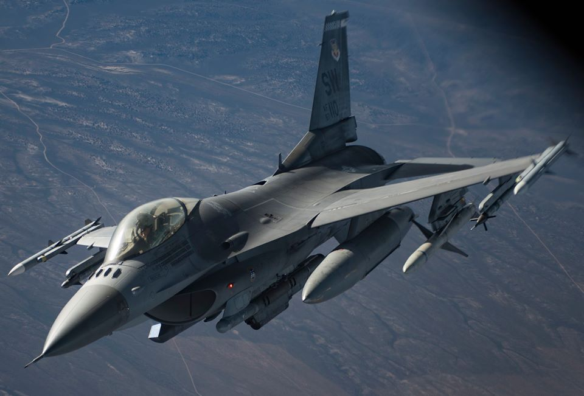
BOMBING MISSION

Slide 30
MISSION DETAILS
Destroy enemy command and control center
F-16 fighter jet
Two 2000-pound bombs guided by Joint Direct Attack Munitions (JDAMs): use GPS to guide bombs to the target once they are released.

Slide 31
PRE-FLIGHT BRIEFING
Target description
Target location: coordinates
Weapons: two 2000 lb. bombs guided by JDAMs with delayed fuse will destroy target while avoiding or minimizing civilian harm
Desired point of impact of bombs to aim them
Weather forecast: overcast with some rainfall

Slide 32
STAGE FIVE MISSION EXECUTION STEPS
FIND: target coordinates loaded into aircraft computer
operator navigates to “weapons envelope” guided by aircraft computer
FIX: no need for operator visual confirmation
positive identification based on coordinates; bomb GPS will guide bombs to target
TRACK: no need: compound is fixed target
TARGET (APPROVE STRIKE): previously vetted based on law and policy
FIRE: no need for operator to sight the target and aim
bombs’ computers indicate optimal time to release weapons guided by GPS

Slide 33
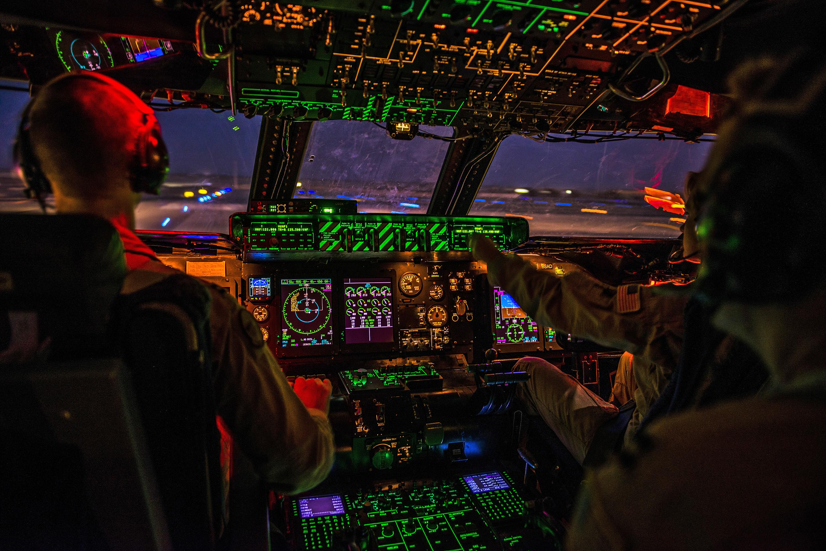
EXECUTION STAGE: HUMAN IN THE LOOP

Slide 34
EXECUTION STAGE HUMAN TASKS
Load target coordinates into aircraft computer
Load impact angle into aircraft computer
Load velocity of plane into aircraft computer
Navigate to weapons envelope guided by aircraft computer
Release weapons based on bomb computer instruction
GPS guides bombs to target

Slide 35
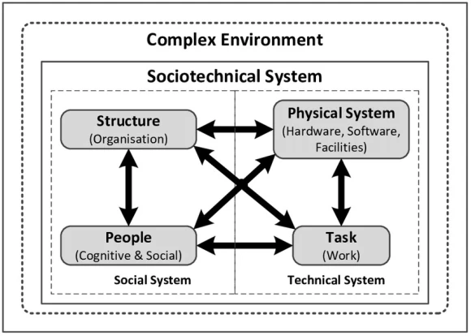

Slide 36


Slide 37


Slide 38
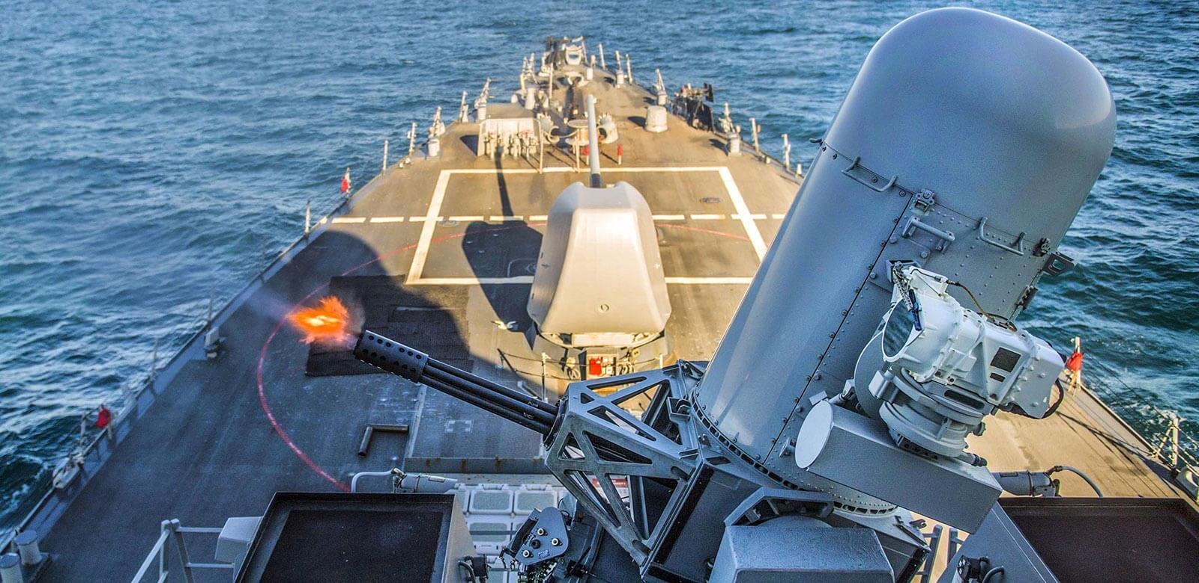
COUNTER-ROCKET, ARTILLERY, AND MORTAR (C-RAM) SYSTEMS.

Slide 39
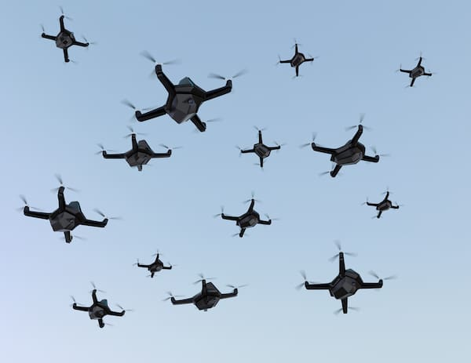
DRONE SWARMS

Slide 40
Framework for Considering Human Control

Slide 41

STATE RESPONSIBILITY

Slide 42
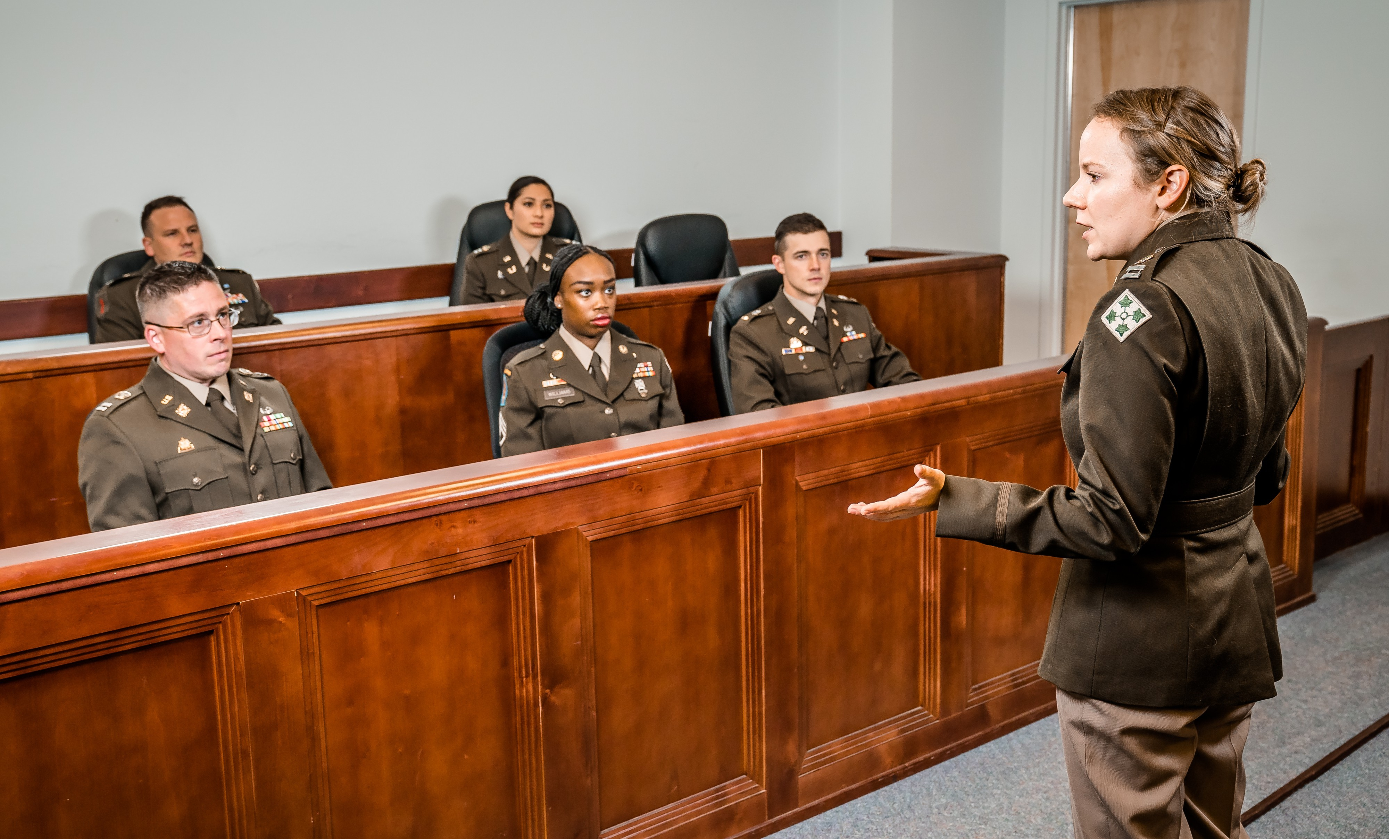
COMMAND RESPONSIBILITY

Slide 43
COMMAND RESPONSIBILITY
What a reasonable commander would have done under the circumstances in reliance on reasonably available information about the expected effects of an attack.

Slide 44
BEYOND HUMAN IN THE LOOP
“There’s often an assumption that keeping a human ‘in the loop’ who has to approve targeting decisions solves the problem of lethal autonomous weapon systems.
What matters, however, is not just whether a human is involved, but how they interact with the AI system in practice.
If this is not thought through carefully, the results can be disastrous regardless of whether the human or machine has final say.”
-- Helen Toner, Georgetown Center on Security and Emerging Technology

